Slide 1


B-Cell Analysis in Type 1 Diabetes
Naoko Ishibashi
October 21, 2024

Slide 2
Project Overview
This project focuses on understanding how B-cells, a crucial part of the immune system, differ between individuals with type 1 diabetes and healthy individuals.
We aim to explore differences in clone size, mutation rates, and V-gene usage between the two groups to better understand immune response changes associated with type 1 diabetes.

Slide 3

Key Research Questions
1. Is there a correlation between B-cell clone size and mutation rate?
2. How consistent is V-gene usage across different individuals?
3. How does type 1 diabetes impact the overall clonal repertoire of B-cells?
4. Compare B-cell characteristics between healthy individuals and those with type 1 diabetes.
z

Slide 4
Data Summary
The dataset consists of B-cell clonotype information from 6 individuals: 3 healthy donors and 3 donors with type 1 diabetes.
Analyzed:
Clone size (number of copies),
V-gene usage (types of B-cells),
Mutation rate (average V-gene identity).

Slide 5
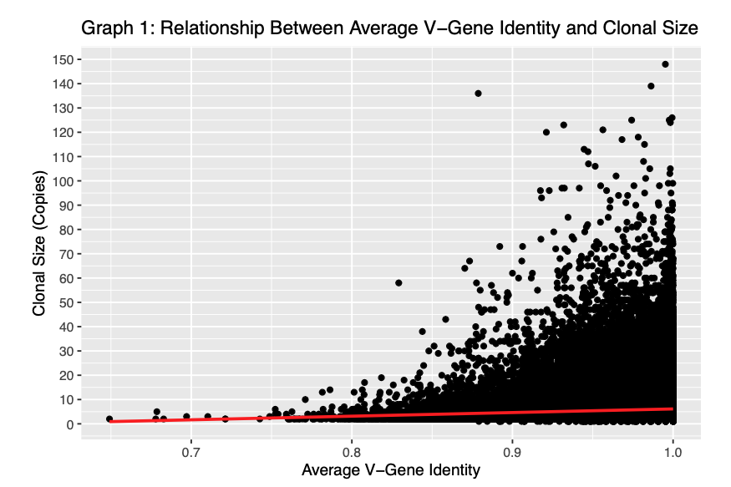
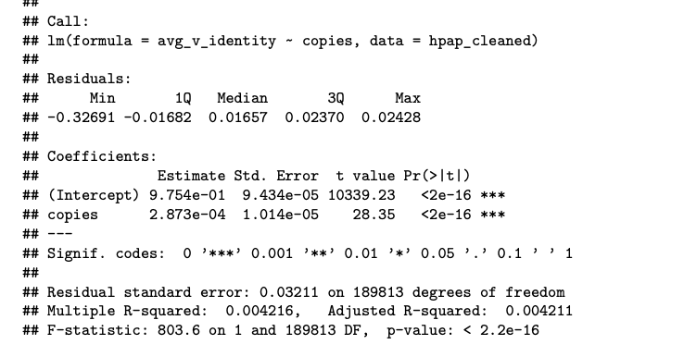
Q1. Correlation Between Clone Size and Mutation
Objective: Determine if there is a correlation between B-cell clone size and mutation rate.
Findings:
Larger B-cell clones show a slight increase in mutation rate, but the correlation is weak.
There is a significant relationship between copies and avg_v_identity.
P-value: A p-value of < 2.2e-16 indicates high significance.
Rejecting the Null Hypothesis: The very small p-value (< 2.2e-16) gives us confidence that the relationship is relevant, not due to chance.
Key Insight: Although the relationship is statistically significant, the effect is small.

Slide 6
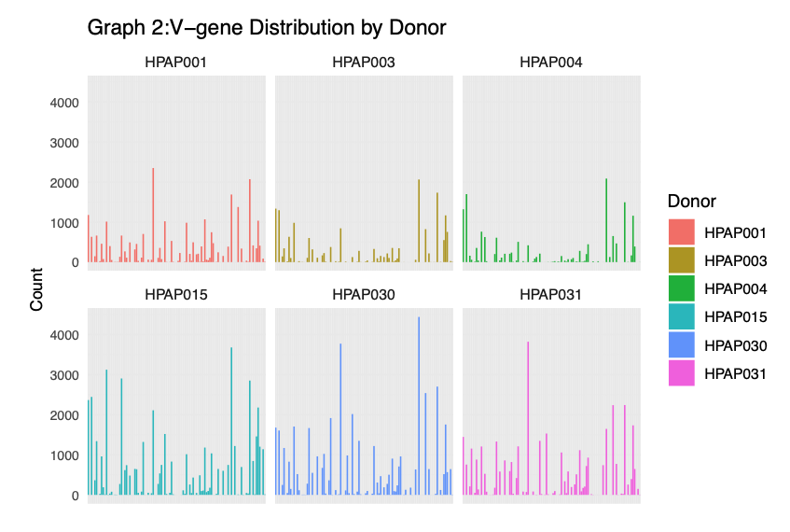
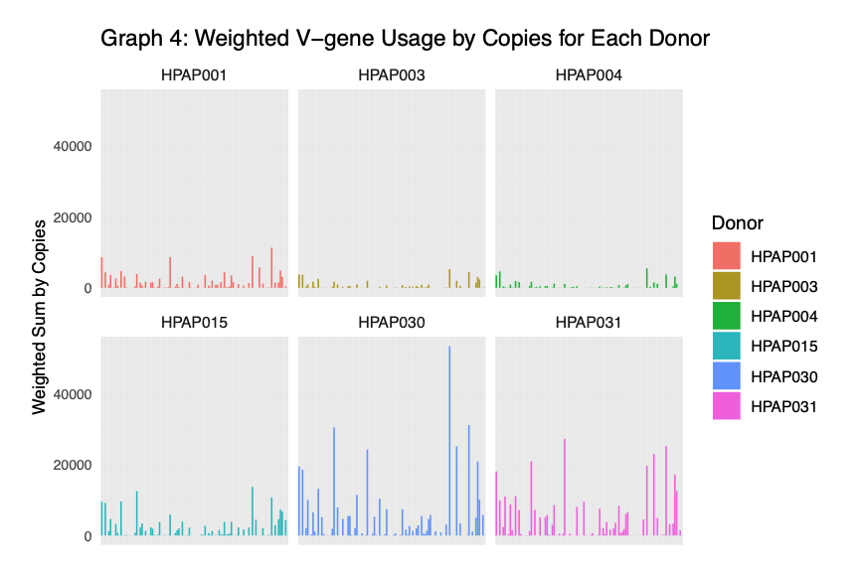
Q2: V-gene distribution among donors
Objective: Investigate whether V-gene usage is consistent across individuals.
Finding: V-gene usage shows variation between donors.
Key Insight: Diabetic donors tend to rely more heavily on certain V-genes.

Slide 7
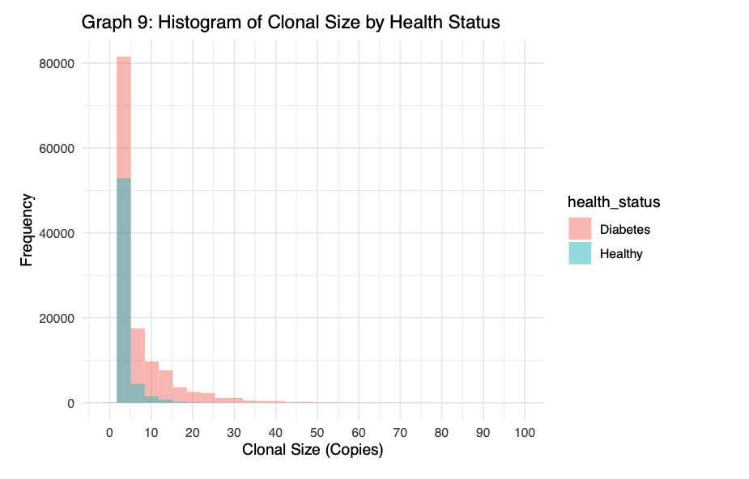
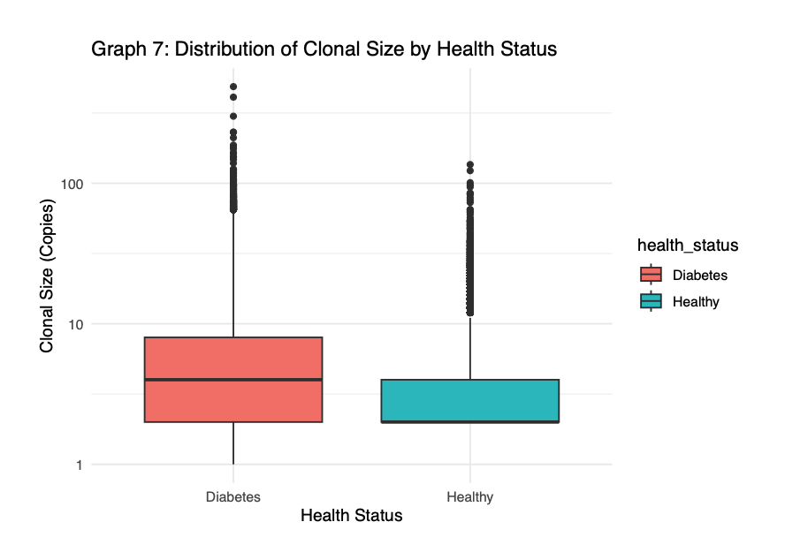
Q3: Impact of Disease on Clonal Repertoire
Objective: Assess how type 1 diabetes affects the overall clonal repertoire of B-cells, with a focus on clone size.
Finding: Individuals with type 1 diabetes have larger B-cell clones compared to healthy individuals.
Key Insight: The expansion of larger clones in diabetic individuals suggests a heightened response compared to healthy individuals.

Slide 8
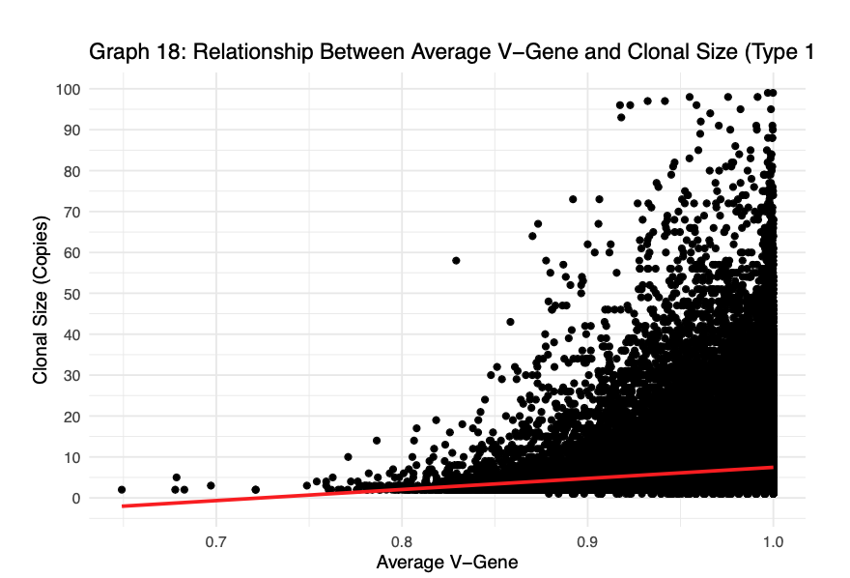
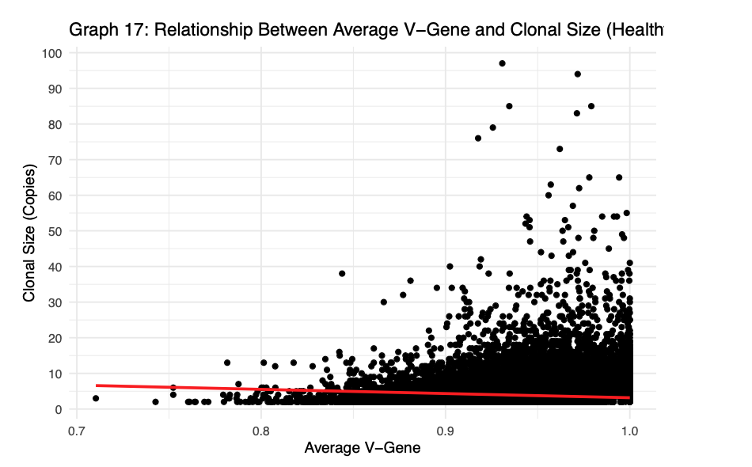
Q4. Healthy vs. Diabetic Clonal Behavior
Objective: Explore how clonal behavior (size and mutation) differs between healthy and diabetic individuals.
Finding: In healthy individuals, larger clones tend to have fewer mutations. In diabetic individuals, larger clones exhibit more mutations.
Key Insight: The opposite mutation patterns in healthy vs. diabetic individuals suggest that these patterns could help predict outcomes in diabetic patients.

Slide 9
Key Takeaways
There is a weak but statistically significant correlation between B-cell clone size and mutation rate.
V-gene usage varies between individuals, with notable differences between healthy and diabetic donors.
Type 1 diabetes is associated with larger and more diverse B-cell clones, potentially reflecting an overactive immune response.

Slide 10

Conclusion
The analysis highlights clear differences in B-cell behavior between healthy and diabetic individuals, particularly in terms of clonal size, mutation rates, and V-gene usage.
These findings provide insight into how the immune system may be altered in type 1 diabetes.

